Slide 1

#DDDAdelaide / @DDDAdelaide

Slide 2














GOLD SPONSORS
SA SPONSORS
WITH SUPPORT FROM

Slide 3
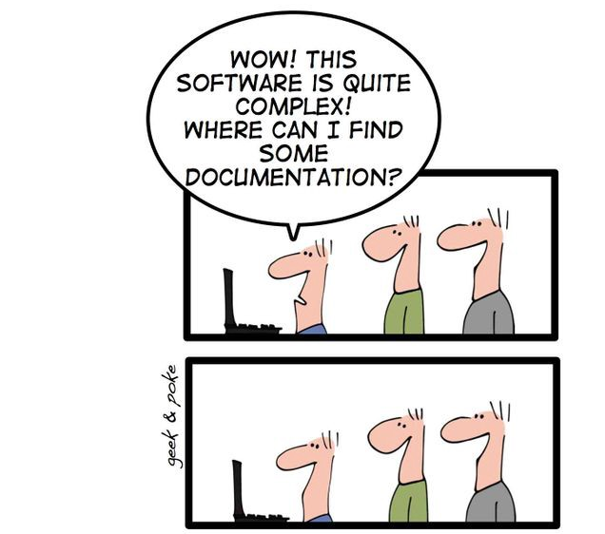
Documentation for Developers

Slide 4
Documentation for Developers

Slide 5
Developers
Do
Documentation
ADELAIDE
https://geekandpoke.typepad.com/geekandpoke/2009/12/we-all-had-our-dreams.html

Slide 6


About Me
Currently
Practice Director
Principal Consultant
CTO
Previously
Various Enterprise, Startup, and Freelance

Slide 7
Why do we document things?
should we
Communicate complex systems easier
Reduce cognitive load
Team member on-boarding
Software and Solution Architecture
Architectural Guidelines and Principles
Decisions and rationale
Disaster recovery
Future you will forget what the heck you did this week!
Notes:
How can we get a new person up to speed as quickly as possible?

Slide 8
So, then why aren’t we doing this?
Documentation is boring
Documentation gets out of date and must be maintained
It breaks the flow of software development
Often requires special tooling, or licenses
Diagramming tools are often hard to version control
Perfect is the enemy of done

Slide 9
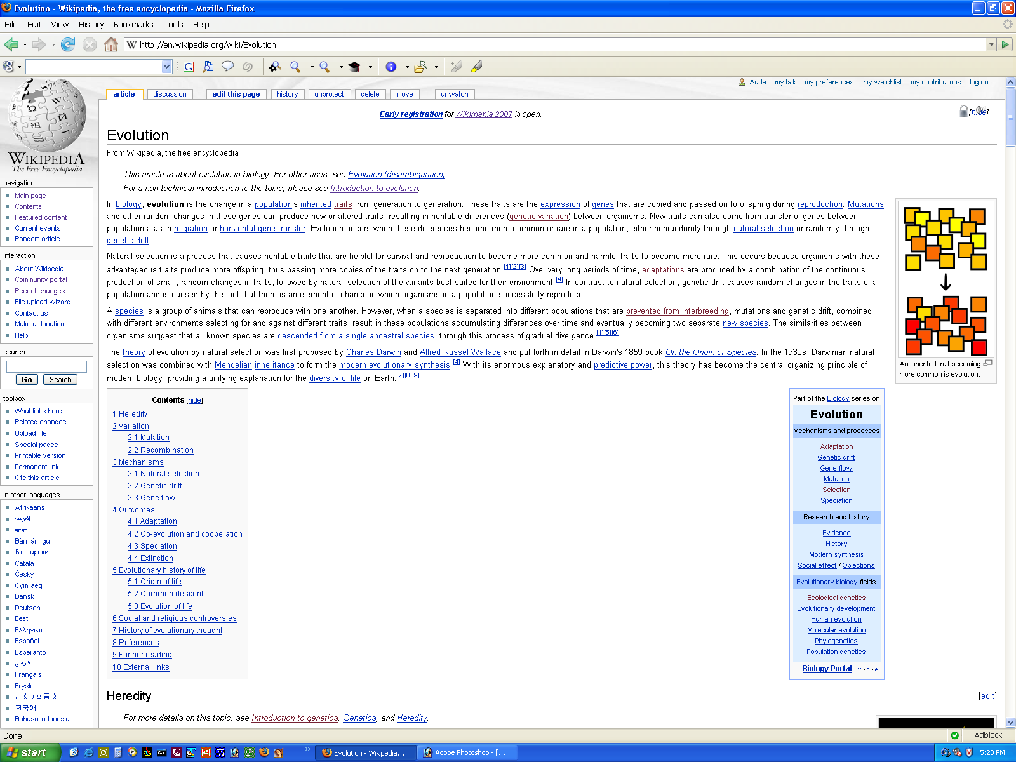
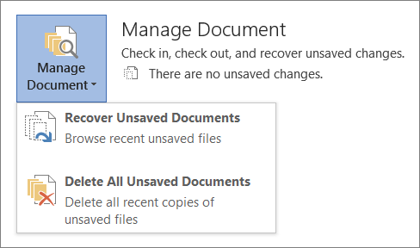
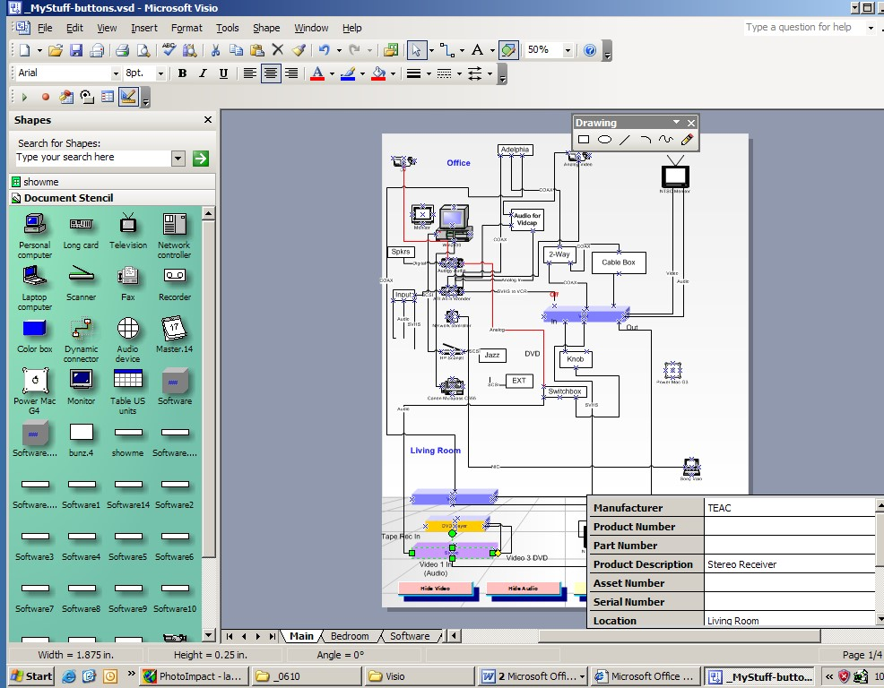
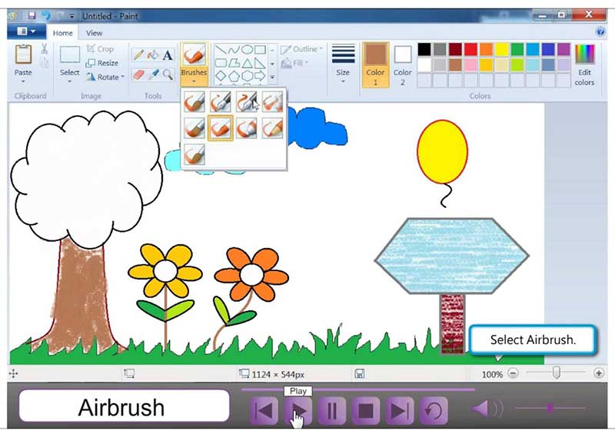
Traditional approach
Wikis, Confluence
Word Documents
Specialised tools
Visio
Draw.io
Paint
Illustration Tools

Slide 10
A possible solution?
Adopt “Documentation as Code”
Favour the separation of structure from presentation
Minimise requirement for extra tooling
Version controlled in git
Be pragmatic, start simple, scale up

Slide 11
Pros
Cons
Version controllable / diffable
Simple to use / learn
Using a DSL vs just diagrams means there is context
Cross platform
Minimal tooling
Can generate images / pdf / ppt
Minimal licensing
The learning curve
Less accessible to non-tech folk
Harder to search & aggregate (solvable)
Code sprawl (solvable)

Slide 12

A consulting story
A new project
A handful of repositories
No documentation
Where do we start?

Slide 13
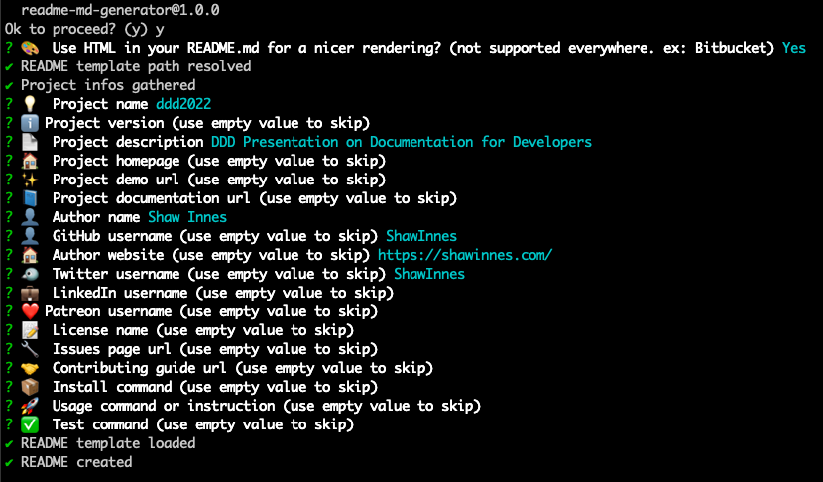
Markdown README
A quick intro for onboarding
Use a template for consistency
Customise for your company
Use readme-md-generator
Or Google for examples
Notes:
What’s the minimum amount of information someone needs to get up and running
We always look at READMEs as part of our interview process
https://github.com/kefranabg/readme-md-generator

Slide 14

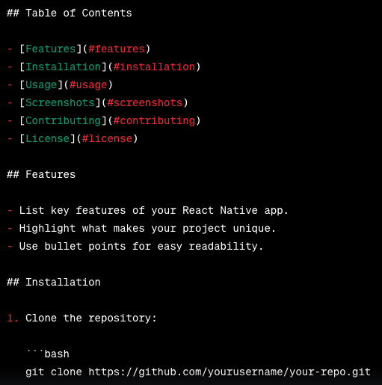
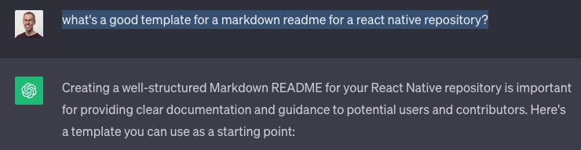
Markdown README
A quick intro for onboarding
Use a template for consistency
Customise for your company
Google for examples
Ask ChatGPT
Notes:
What’s the minimum amount of information someone needs to get up and running
We always look at READMEs as part of our interview process
https://github.com/kefranabg/readme-md-generator

Slide 15
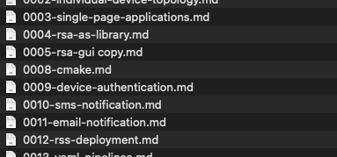
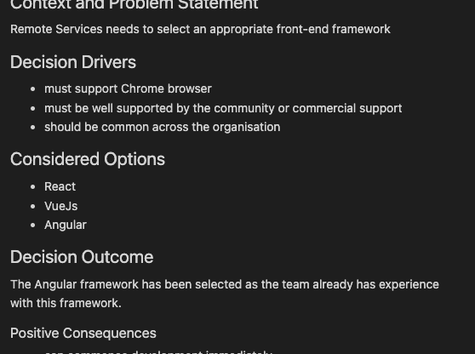
Tracking Decisions
Markdown Decision Records (MADR)
Context/Problem
Considered Options
Decision
Consequences
Create an index for easy reference
Notes:
As we start to understand decisions that have been made either through inspection or by talking to the team, we want to capture those
On a new project we want to start with these
Minimise the amount of time revisiting made decisions every time a new person joins

Slide 16
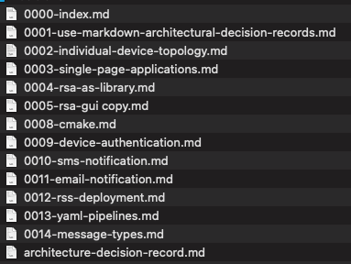
Tracking Decisions
Markdown Decision Records (MADR)
Context/Problem
Considered Options
Decision
Consequences
Create an index for easy reference
Notes:
As we start to understand decisions that have been made either through inspection or by talking to the team, we want to capture those
On a new project we want to start with these
Minimise the amount of time revisiting made decisions every time a new person joins

Slide 17
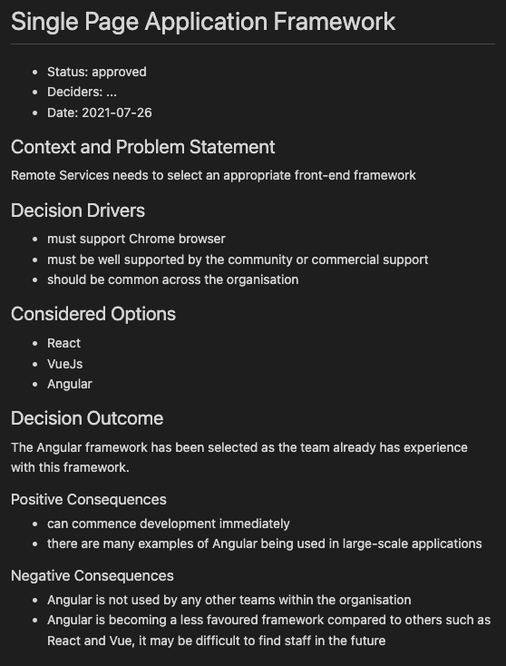
Tracking Decisions
Markdown Decision Records (MADR)
Context/Problem
Considered Options
Decision
Consequences
Create an index for easy reference
Notes:
As we start to understand decisions that have been made either through inspection or by talking to the team, we want to capture those
On a new project we want to start with these
Minimise the amount of time revisiting made decisions every time a new person joins

Slide 18
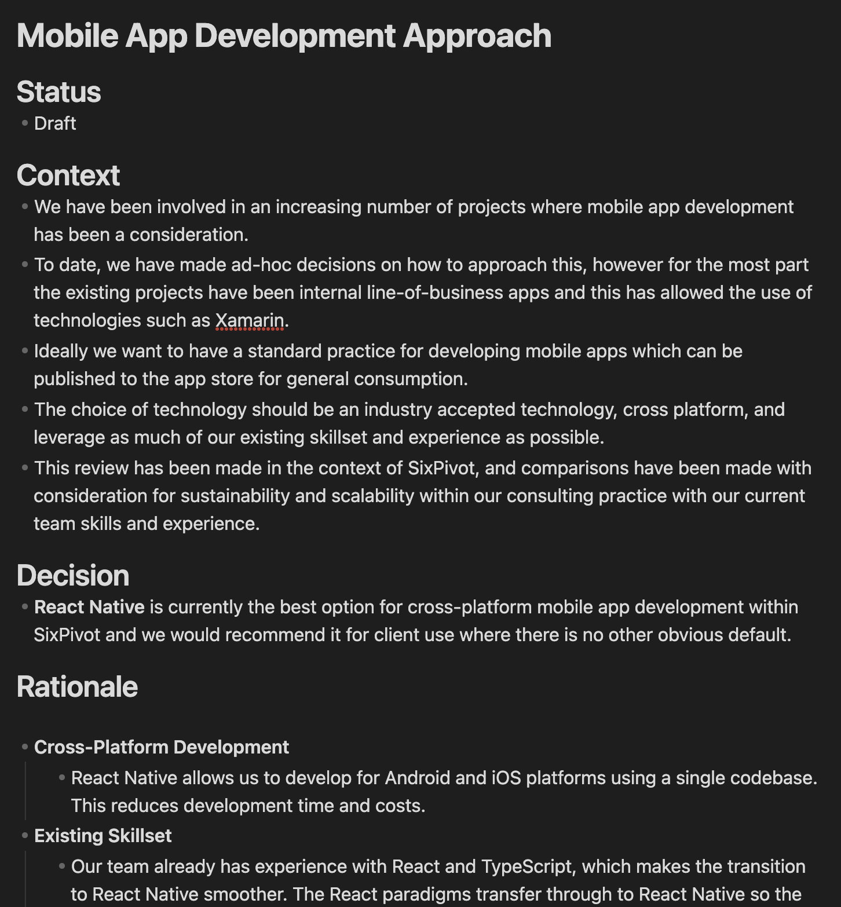
Tracking Decisions
Markdown Decision Records (MADR)
Context/Problem
Considered Options
Decision
Consequences
Create an index for easy reference
Notes:
As we start to understand decisions that have been made either through inspection or by talking to the team, we want to capture those
On a new project we want to start with these
Minimise the amount of time revisiting made decisions every time a new person joins

Slide 19
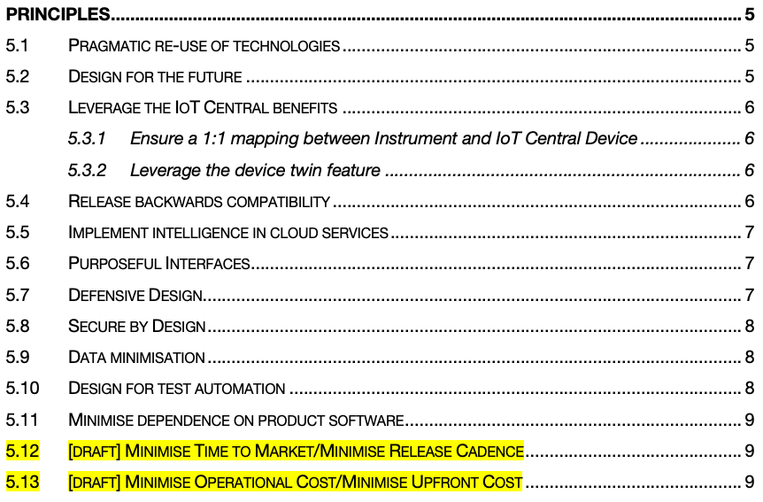
Architectural Guidance
Architecture Principles
Capture expectations/assumptions
Make it easier for developers to make decisions
Could this meeting have been a Principle?
Notes:
My pet hate is having to enlist the opinion of an architect every time you want to extend a solution
Can we come up with some guidelines and principles to help push decision making to the development teams?
Then if something isn’t covered in the architectural principles, consult an architect.

Slide 20
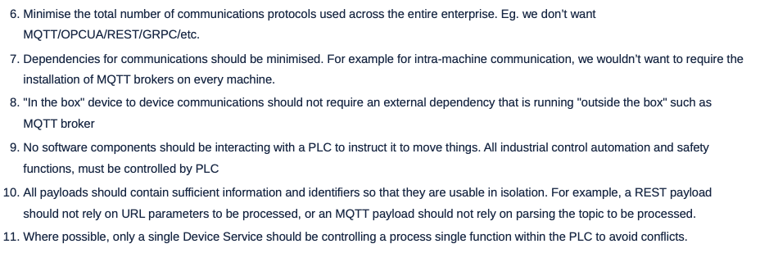
Architectural Principles
Well-defined principles
Name: Succinct, easy to remember, and carries the essence of the rule (few words)
Statement: Unambiguous statement defining the rule (1 to 3 sentences)
Rationale: Why is this rule important, particularly in terms of business benefits.
Implications: Identifies explicitly how the rule affects the business, teams, etc.
Notes:
1. **Name**: A principle's name should be crisp, resonant, and reflective of its core idea. Think of it as a label that encapsulates its essence in a memorable way.
2. **Statement**: The statement should be clear and concise, avoiding technical jargon when possible. This ensures that the principle is comprehensible and can be consistently applied by everyone, from IT personnel to business executives.
3. **Rationale**: The reasoning behind a principle provides the 'why,' connecting it to tangible business outcomes. It helps stakeholders understand the value and importance of adhering to the principle.
4. **Implications**: Outlining the implications clarifies the expected changes or actions required. It should illuminate the impact on processes, organizational structures, and the behavior of teams.

Slide 21

Diagramming - PlantUML
Text-based diagramming
Support for multiple diagram types
Sequence diagram
Class diagram
Activity diagram
Entity Relationship diagram
Extensible with Libraries
Azure, Kubernetes, AWS, C4…
Tooling
Visual Studio Code + Extensions
Supported by JetBrains and others also
Supported in various Markdown wikis
* Mermaid is another good option
Notes:
https://plantuml.com/
https://crashedmind.github.io/PlantUMLHitchhikersGuide/
https://github.com/plantuml/plantuml-stdlib

Slide 22
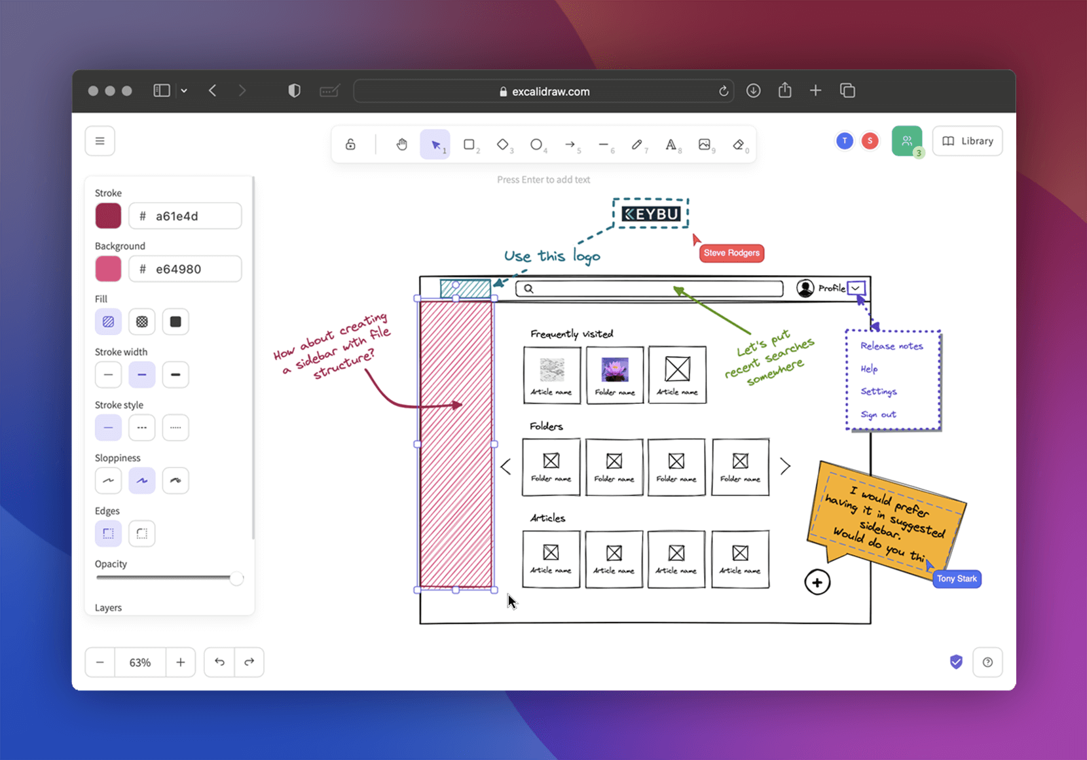
Diagramming - Excalidraw
Traditional diagramming
Browser-based
Open JSON format file
Notes:
https://plantuml.com/
https://crashedmind.github.io/PlantUMLHitchhikersGuide/
https://github.com/plantuml/plantuml-stdlib

Slide 23
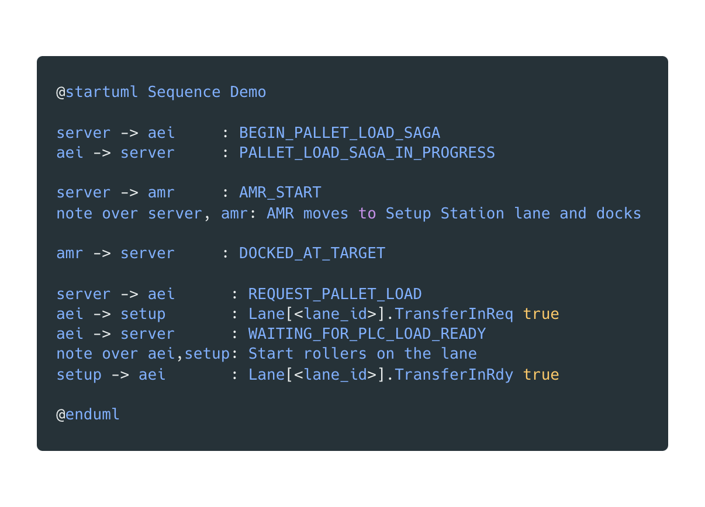
Notes:
01-plantuml-sequence.puml

Slide 24
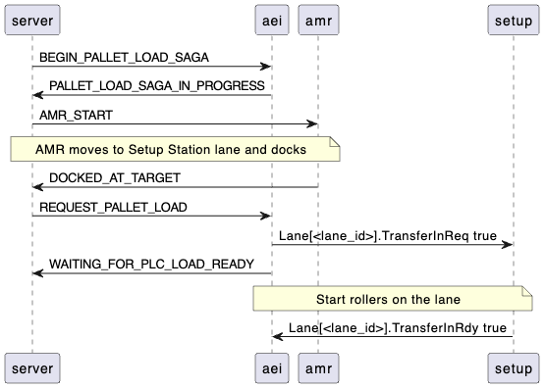
Notes:
01-plantuml-sequence.puml

Slide 25
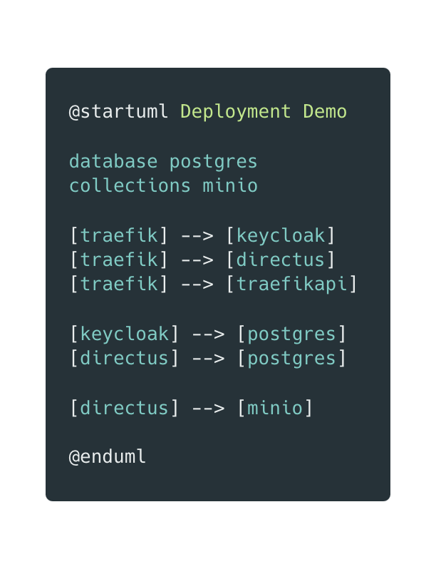
Notes:
01-plantuml-sequence.puml

Slide 26
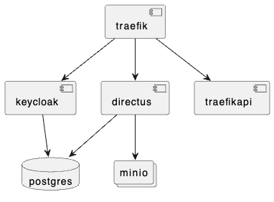
Notes:
01-plantuml-sequence.puml

Slide 27
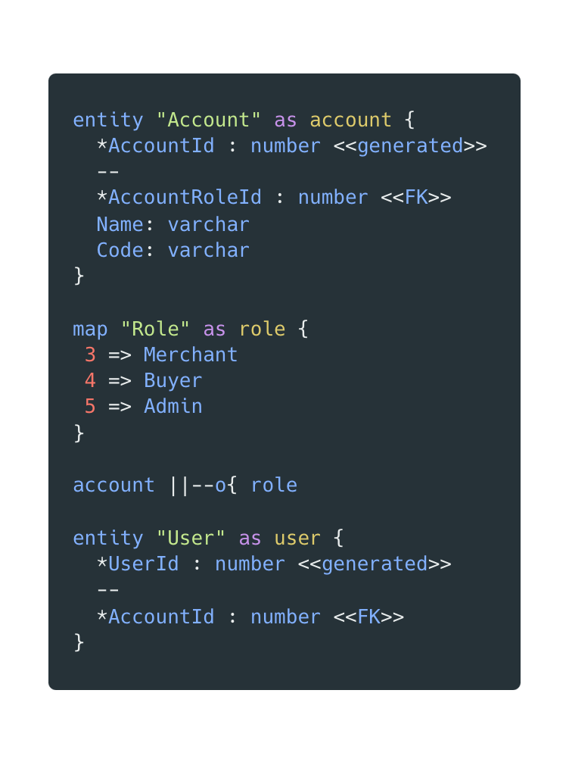
Notes:
01-plantuml-sequence.puml

Slide 28
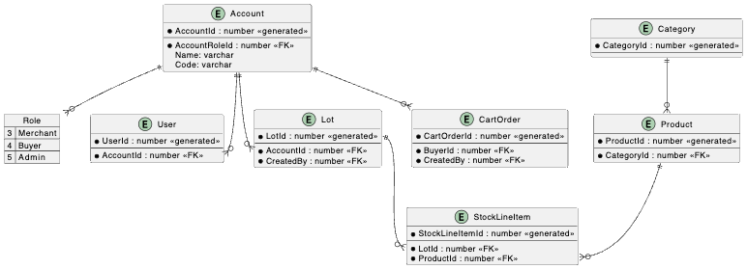
Notes:
01-plantuml-sequence.puml

Slide 29
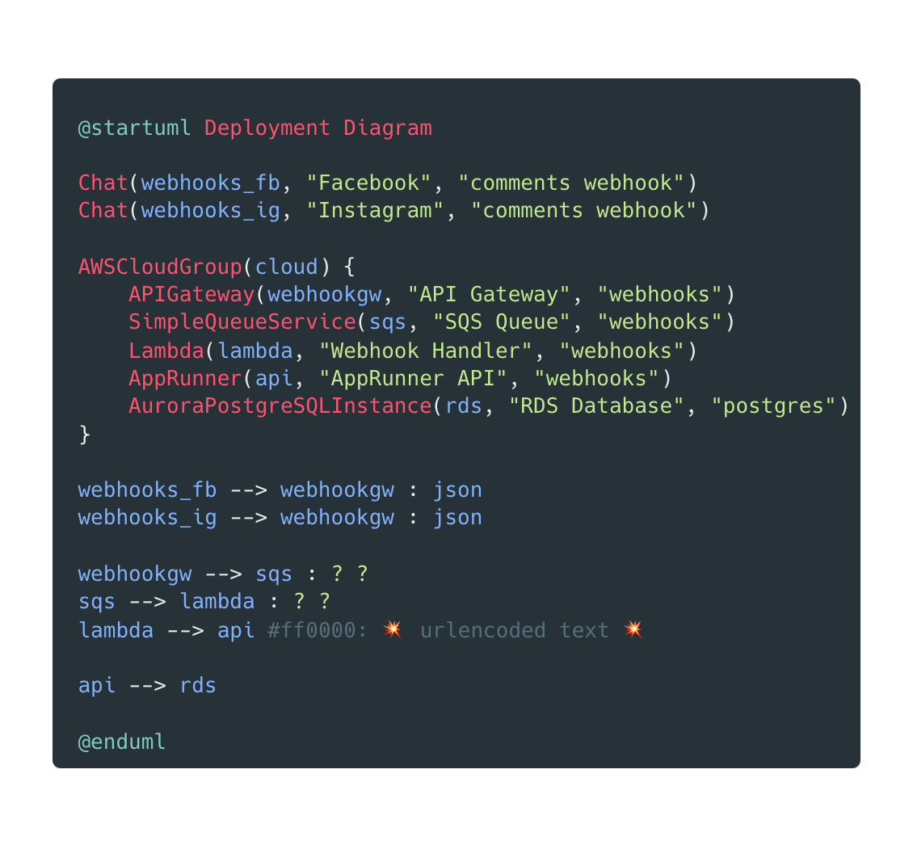
Notes:
01-plantuml-sequence.puml

Slide 30
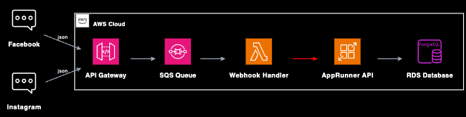
Notes:
01-plantuml-sequence.puml

Slide 31
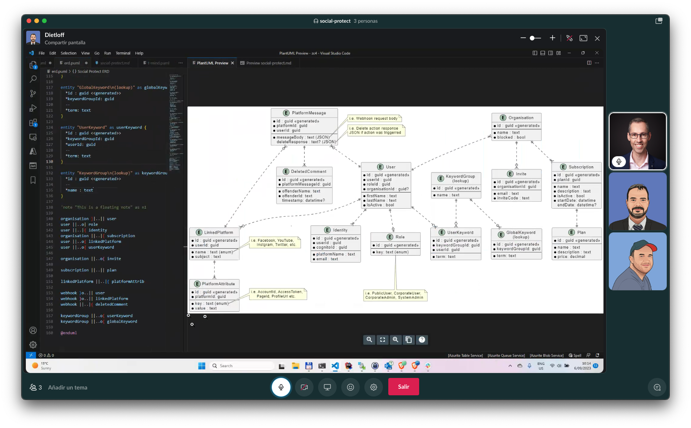

Slide 32
C4 Model
Simple abstractions & Standard diagram types
Helps avoid overly-complex diagrams
Context (level 1): system scope, users and other systems
Container (level 2): represents an application or a data store
web application, mobile app, serverless function, embedded device
Component (level 3): internals of a container
Code (level 4): class-level decomposition
Deployment: optional, and very useful
Notes:
I’ve found C4 to be really beneficial at stopping myself and others from trying to cram everything onto a single diagram
https://c4model.com/
https://adrianvlupu.github.io/C4-Builder/
https://github.com/plantuml-stdlib/C4-PlantUML
https://c4model.com/review/

Slide 33
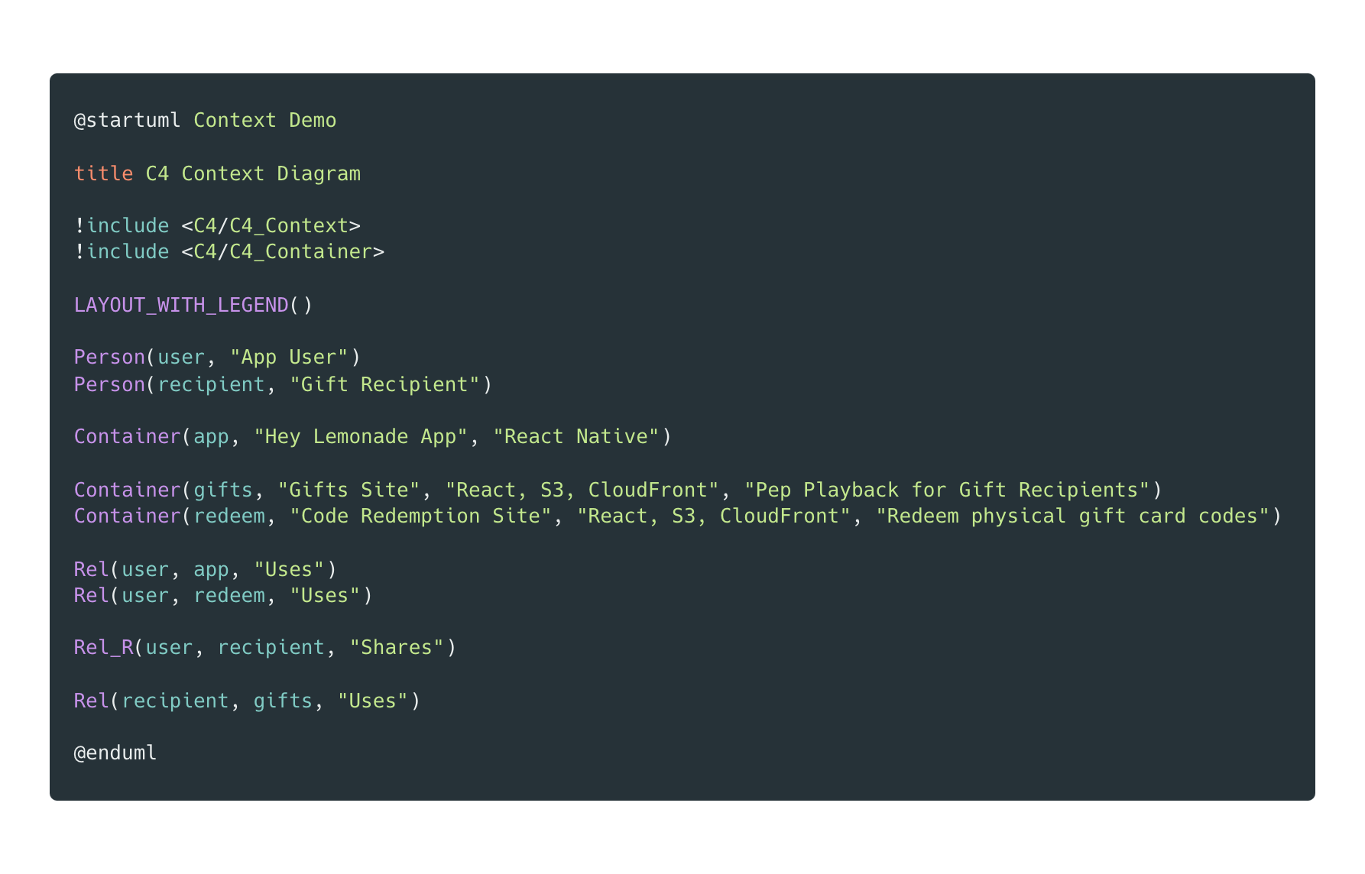
Notes:
01-plantuml-sequence.puml

Slide 34
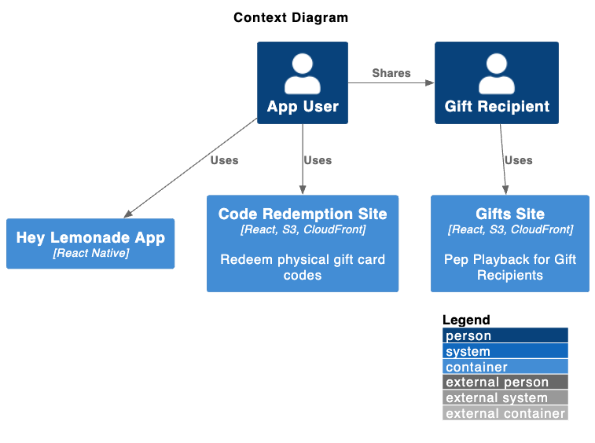
Notes:
01-plantuml-sequence.puml

Slide 35
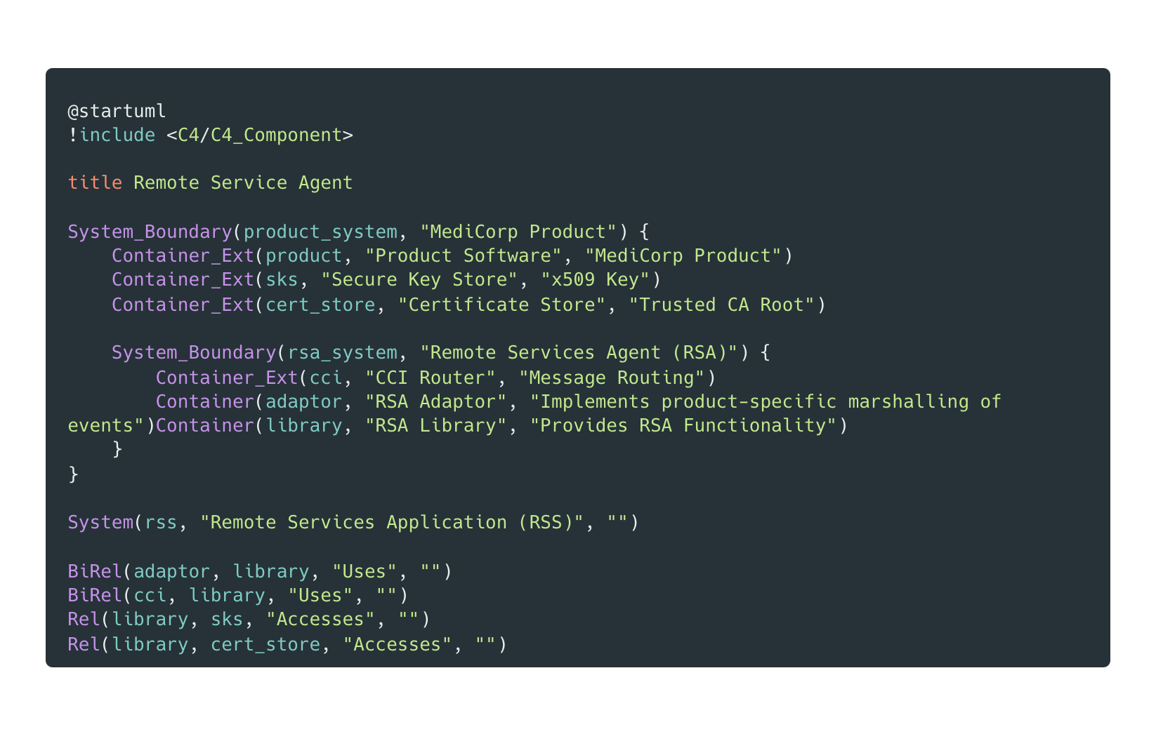
Notes:
01-plantuml-sequence.puml

Slide 36
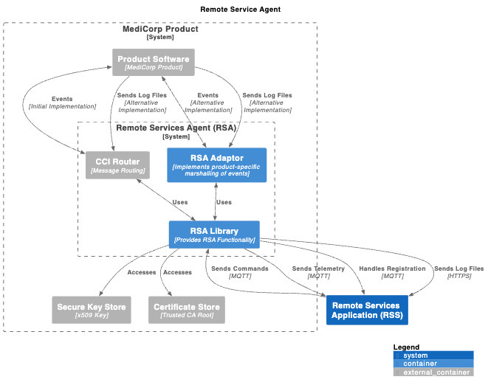
Notes:
01-plantuml-sequence.puml

Slide 37
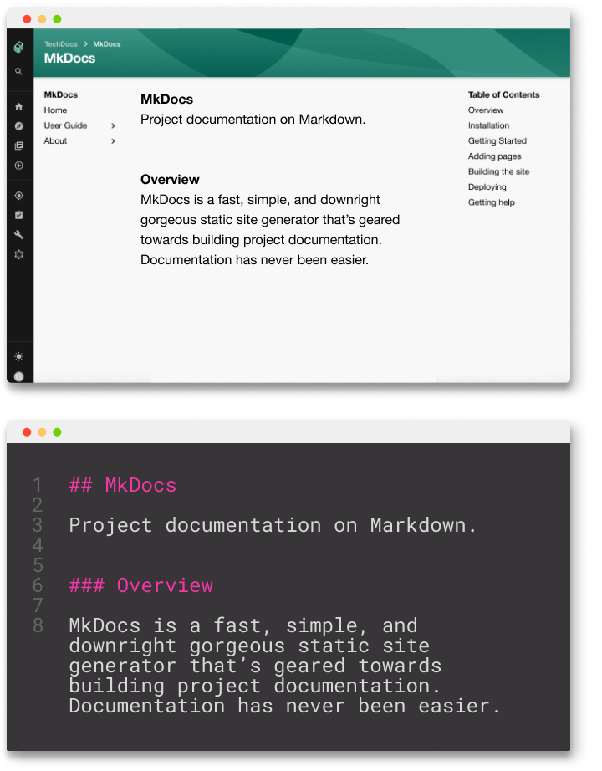
Bringing it all together
Add Markdown front-matter for metadata
Roll your own scripts
Output to PDF in CI/CD pipelines
Tools like C4 Builder
Mkdocs & Mkdocs material 😍
Docusaurus 🦖
Backstage TechDocs 🚀
Notes:
Now there is a lot of documentation across multiple repos, how to make it searchable
https://adrianvlupu.github.io/C4-Builder/
https://pandoc.org/

Slide 38
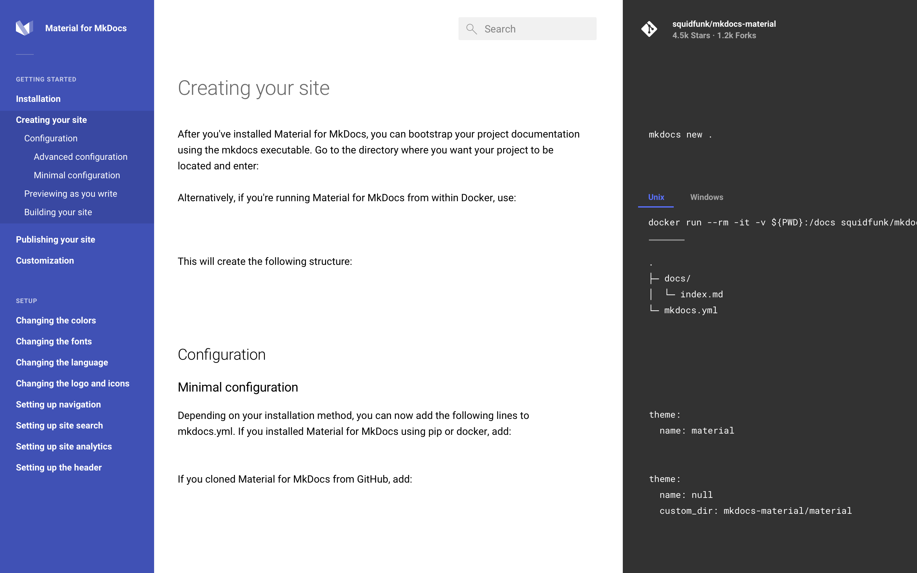
Mkdocs
Material
Notes:
04-c4model-context-good.puml

Slide 39
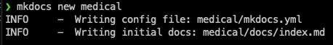
Demo
Mkdocs & Material

Slide 40

Structurizr
Tooling to extend on PlantUML & C4 & ADRs
More control over rendering
Linking between different elements
Model and element reuse
Team sharing
(Also by Simon Brown)
https://structurizr.org/
https://structurizr.com/
https://structurizr.com/help/decision-log

Slide 41

How do you encourage developers to document their code inline? So that code doco can be rendered in the build pipeline.
It’s not something I actively encourage, but it depends on the type of software you’re writing. As with most of the stuff I’ve presented here, be pragmatic.
Through the pull request process is a good way to ensure that code is documented, if required. I would suggest documenting code inline if the intent of the code can’t be clearly understood by a mid-level developer.
However, if you’re creating a library or API that is to be consumed by 3rd parties, then inline documentation might be more useful. In this case I’d look at using convention tests or some other process in your CI build to break the build if a developer adds new code without the expected documentation.

Slide 42
Can you recommend a good starting template for an Architectural Guidance doc?
Software Architecture for Developers – Simon Brown http://leanpub.com/software-architecture-for-developers
Creating Software with Modern Diagramming –Ashley Peacock https://pragprog.com/titles/apdiag/creating-software-with-modern-diagramming-techniques/
As much as I would hate to recommend TOGAF…
https://pubs.opengroup.org/architecture/togaf8-doc/arch/chap29.html

Slide 43
Any alternatives to PlantUML? Have you looked at mermaid?
Yep, I’ve used mermaid. It’s a good option because it seems to be natively supported by more wikis and github etc.
The reason I didn’t talk about mermaid much is because it’s a bit limited in functionality compared to PlantUML. Having said that, if it’s supported by your platforms then mermaid is a good option. It’s also relatively straight forward to move from mermaid to PlantUML later if you need the extended functionality.
From a documentation point of view, a couple of people suggested Asciidoc during the Q&A session. I haven’t looked into this heavily but I think it’s worth a look as well, especially for creating large-scale user documentation.
Another project I recently came across is kroki.io – it seems to be an amalgamation of a bunch of other text based documentation projects.

Slide 44
Can you do cloud infrastructure diagram? Also, can you add images (logos)?
Absolutely. There are a ton of PlantUML libraries for this:
https://github.com/plantuml-stdlib/Azure-PlantUML
https://github.com/awslabs/aws-icons-for-plantuml
https://github.com/dcasati/kubernetes-PlantUML
https://crashedmind.github.io/PlantUMLHitchhikersGuide/aws/aws.html

